Slide 1
Azure Cosmos DB Live TV Python SDK
Rodrigo Souza – Program Manager – Azure Cosmos DB Team

Slide 2
Agenda
Presentation
Statistics
Use Cases
Last Updates
FAQs
Roadmap
Key Links
GitHub + Demos

Slide 3
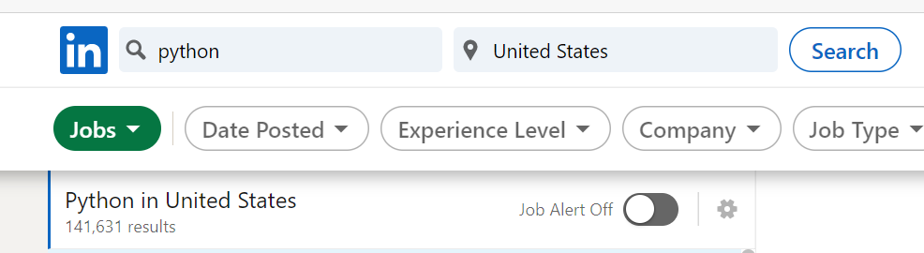
Python Statistics
LinkedIn: +140K Jobs just in the US
GitHub: 2nd
Google Trends 2020: 1st
Cosmos DB SDK: ~1 Billion requests per day

Slide 4
Use Cases
Typical Use Cases
IoT
Devices Management
Serverless applications
New Trends
Data Exploration
Data Engineering
Data Science

Slide 5
Last Updates
Support for passing partition Key while querying Change Feed
Creation of analytical store enabled containers
Added query Distinct, Offset and Limit support
Documentation
Azure.com
GitHub

Slide 6
FAQs
Current version 4.2.1
SQL API only
For other APIs, just use the typical client like pymongo
TABLE API is a separated SDK
Yes, it’s built-In in Cosmos DB Notebooks. But it has an enhanced implementation
It doesn’t support the same features of other SDKs. Limitations are listed in GitHub
Yes, we enjoy collaboration. Please use GitHub issues and PRs.
Yes, V4 is in a different GitHub repo (Azure / azure-sdk-for-python)
Breaking changes
V1 -> V2
V2 -> V3
V3 -> V4

Slide 7
Roadmap
CY 2021
Group BY
Async I/O
CY 2022
Bulk/Transactional batch processing
Direct TCP Mode access
Continuation token for cross partitions queries

Slide 8
Key Links
GitHub: https://aka.ms/cosmosdb/sql-api-sdk-python
Auto Generated Documentation: https://aka.ms/azsdk-python-cosmos-ref
Documentation: https://aka.ms/cosmosdb/sql-api-sdk-python-doc
Package: https://pypi.org/project/azure-cosmos/

Slide 9
Thank you! Rodrigo Souza

